Slide 1
CodeUp: Marking up Programming Languages and the winding road to an XML Syntax.
David Lee, Lead Engineer Balisage, Aug 8, 2012

Slide 2
Marking Up Programming Languages
Why MarkUp Programming Languages ?
Why MarkUp Text ?

Slide 3
Default Bullet Slide Master
Bullet 1, Tahoma Regular 20pt, Sentence case
Bullet 2, Tahoma Regular 18pt, Sentence case
Bullet 3, Tahoma Regular 16pt, Sentence case
Bullet 4, Tahoma Regular 14pt, Sentence case
Hyperlink: www.marklogic.com
Use green Tahoma 20pt to emphasize words

Slide 4
Bullet Slide with Subtitle
Subtitle, Tahoma Bold 22 pt
Bullet 1, Tahoma Regular 20pt, Sentence case
Bullet 2, Tahoma Regular 18pt, Sentence case
Bullet 3, Tahoma Regular 16pt, Sentence case
Bullet 4, Tahoma Regular 14pt, Sentence case
Hyperlink: www.marklogic.com
Use green Tahoma Bold 20pt to emphasize words

Slide 5
Two Column Slide with Heading
Column Heading
Column Heading
First Bullet
First Bullet
First Bullet
Second bullet
Second bullet
Second bullet
Third bullet
First Bullet
First Bullet
First Bullet
Second bullet
Second bullet
Second bullet
Third bullet

Slide 6
Two Column Slide, No Heading
First Bullet
First Bullet
First Bullet
Second bullet
Second bullet
Second bullet
Third bullet
First Bullet
First Bullet
First Bullet
Second bullet
Second bullet
Second bullet
Third bullet

Slide 7
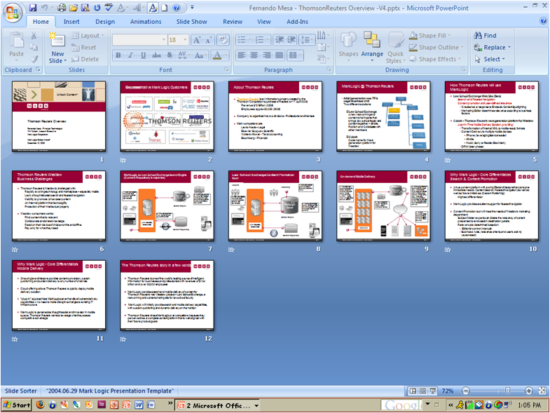
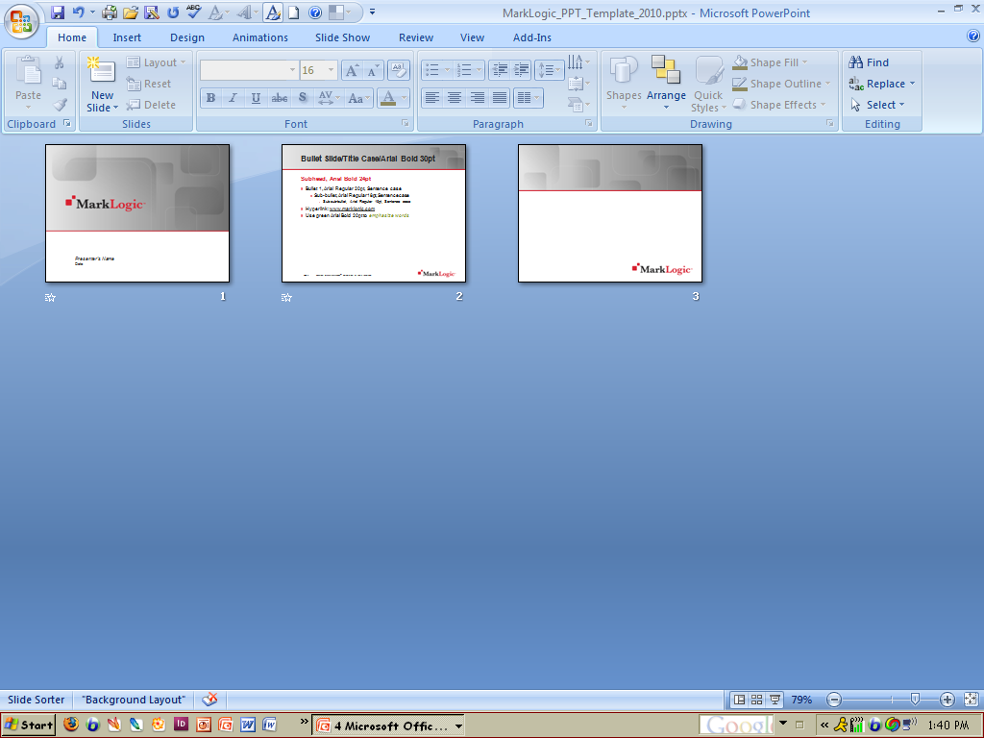
Copying Slides From Slide Sorter View Into the New Template
1
Your Working File
Select all slides and copy
MarkLogic Template
Notes:
7

Slide 8
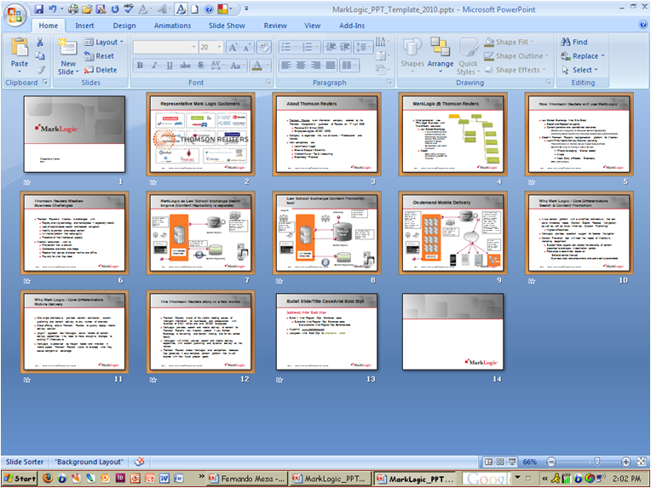
Copying Slides From Slide Sorter View Into the New Template
2
MarkLogic Template
Paste into the MarkLogic Template in Slide Sorter view
Select Clipboard
Select “Use Destination Theme”
Notes:
8

Slide 9
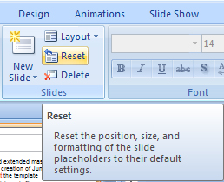
Applying the Theme and Slide Layouts to Your New File
3
Your New File
Right-click and select desired slide layout
“Reset” slide layout
Notes:
9

Slide 10
Color Palette
Logo and Text Colors
R
G
B
217
34
49
32
32
32
65
65
65
Primary Graphic Colors
R
G
B
169
181
51
253
184
19
0
140
203
138
155
60
236
125
30
0
100
157
These colors are used to augment an illustration when differentiation is needed for tags, text boxes, labels, etc.

Slide 11
Color Palette Usage
The theme colors are in the top row of your color palette along with a set of tints and shades that are based on the theme colors. By selecting colors from this expanded, matched set, you can make formatting choices for individual pieces of content that follow the theme.

Slide 12
Working With Charts in PowerPoint 2007
Editing Charts in PowerPoint 2007
Double click on the chart you wish to edit
The following prompt will appear
If your chart or graph originated from a previous version of Excel, Word, or PowerPoint (i.e. Microsoft Office 2003), select “Edit Existing” in order to edit the file via the datasheet
If your chart was created in a Microsoft Office 2007 application, or if you have the 2007 version of Word and/or Excel, you can select “Convert” and gain access to the datasheet for edits
Note: In order to incorporate “Shape Effects” or “Quick Styles” to a
chart, it must be converted to a “2007 Office system format”

Slide 13
Creating Custom Charts in PowerPoint 2007
MarkLogic Custom Chart Templates
Four custom chart templates (.crx) have been created specially for MarkLogic:
MarkLogic_Column_Chart.crx
MarkLogic_Bar_Chart.crx
MarkLogic_Line_Chart.crx
MarkLogic_Pie_Chart.crx
They have been uniquely designed in the MarkLogic custom color palette with a rich color gradation that will make your presentations have a custom look and feel
See examples in this presentation style guide, pages 15-18

Slide 14
Creating Custom Charts in PowerPoint 2007
Installing the MarkLogic Custom Chart Templates
In order to use these custom charts you will need to store them in the PPT templates/charts folder on your computer. This folder does not exist in a standard place on all computers.
To install your PPT chart templates file, please follow these steps
Open the MarkLogic master template file
Insert a new slide using the “Header and Content” master
Click on the chart icon in the content placeholder (middle of slide)
In the pop up window, click on “templates”, then “manage templates”. This will show you the location of where you need to store the chart templates.
Copy/paste (or move) the .crx files from the wiki into this folder on your computer.
These custom charts will now be available for your use.

Slide 15
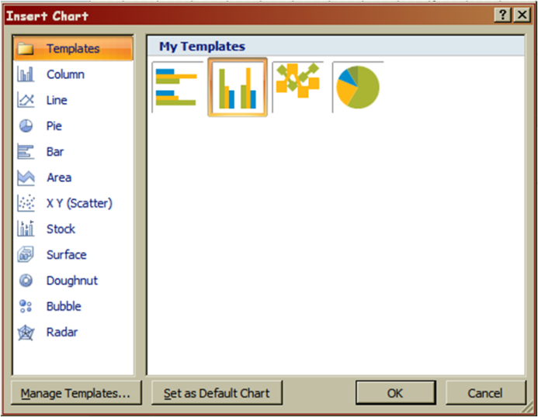
Creating Custom Charts in PowerPoint 2007
Using the MarkLogic Chart Templates
Click on the chart icon
Select one of the four custom templates
Edit chart data as needed

Slide 16
Column Chart

Slide 17
Bar Chart

Slide 18
Line Chart

Slide 19
Pie Chart

Slide 20
Default Table Style
This is the default table style that will appear if you choose the table icon within the content placeholder.
Column 1 | Column 2 | Column 3 | Column 4 | Column 5
Row 1 | Data | Data | Data | Data
Row 2 | Data | Data | Data | Data
Row 3 | Data | Data | Data | Data
Row 4 | Data | Data | Data | Data
Row 5 | Data | Data | Data | Data
Row 6 | Data | Data | Data | Data

Slide 21
Header Only Layout

Slide 23
Section Break or Closing Slide
Phone
Blog
Email

