Slide 1
JXON
An Architecture for Schema and Annotation Driven JSON/XML Bidirectional Transformations
David A. Lee
Senior Principal Software Engineer

Slide 2
An experiment ...

Slide 3
This Presentation ...
IS
Research
Goals
Architecture
How it works !
Case Study
Full of tiny examples
A working implementation ready for download now
IS NOT
Life, the Universe and Everything
Complete details – see the paper for more
An answer to everything
Fulfillment of all goals
API Documentation

Slide 4
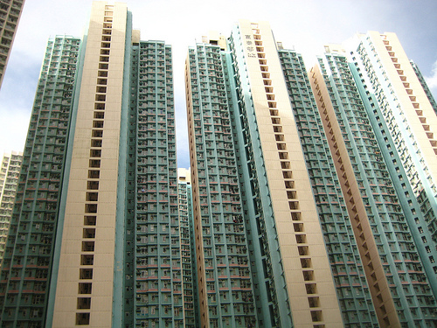
Markup Domains
JSON World
XML World

Slide 5
In the Ideal World ...

Slide 6
JSON and XML would be equivalent ...
XML
JSON
<BOOKS>
<BOOK id="1">
<TITLE>My Favorite Book</TITLE>
<PRICE>1.23</PRICE>
</BOOK>
<BOOK id="1a">
<TITLE>XML for Dummies</TITLE>
<PRICE>5.25</PRICE>
</BOOK>
<BOOK id="3">
<TITLE>JSON for Dummies</TITLE>
<PRICE>200.95</PRICE>
</BOOK>
</BOOKS>
{ "BOOKS" : [
{ "id" : "1" ,
"title": "My Favorite Book" ,
"price" : 1.23 },
{ "id" : "1a" ,
"title": "XML for Dummies" ,
"price" : 5.25},
{ "id" : "3" ,
"title": "JSON for Dummies" ,
"price" : 200.95 }
]}

Slide 7
JSON != XML – they just don't translate easily
How would a translation know to consistently use a string value for "id" and "title" but a numeric value for "price" ?
Where does the "BOOK" element come from when translating to XML ?
How does the JSON to XML transformation code know to make "id" into an attribute in XML but not price or title ?
How does the XML to JSON translation know to construct an array in JSON ?
Where does the name conversion rule for "TITLE" vs. "title" and "PRICE" vs. "price" occur ?

Slide 8
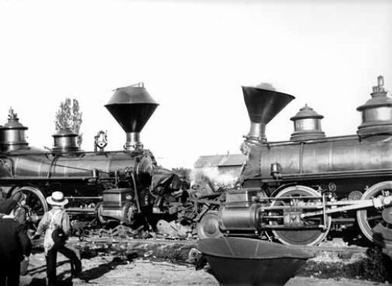
In reality ...

Slide 9
In Reality – json.org XML to JSON
{
"childNodes": [
{
"childNodes": [
{
"childNodes":
["My Favorite Book"],
"tagName": "TITLE"
},
{
"childNodes": [1.23],
"tagName": "PRICE"
}
],
"id": 1,
"tagName": "BOOK"
},
{ "childNodes": [
{
"childNodes":
["XML for Dummies"],
"tagName": "TITLE"
},
{
"childNodes": [5.25],
"tagName": "PRICE"
}
],
"id": "1a",
"tagName": "BOOK"
},
{
"childNodes": [
{
"childNodes":
["JSON for Dummies"],
"tagName": "TITLE"
},
{
"childNodes": [200.95],
"tagName": "PRICE"
}
],
"id": 3,
"tagName": "BOOK"
}
],
"tagName": "BOOKS“ }

Slide 10
In Reality – json.org JSON to XML
<BOOKS>
<id>1</id>
<title>My Favorite Book</title>
<price>1.23</price>
</BOOKS>
<BOOKS>
<id>1a</id><title>XML for Dummies</title>
<price>5.25</price>
</BOOKS>
<BOOKS>
<id>3</id>
<title>JSON for Dummies</title>
<price>200.95</price>
</BOOKS>
Not Well Formed

Slide 11
Interesting Issues
Inconsistent typing of the "id" value
Very verbose and complex JSON representation
JSON arrays where simple values should be used
Pairs of 'name/value' members where native JSON member names should be used
Unnecessary distinctions between how attributes and child elements are serialized

Slide 12
JXON Goals
JSON and XML Converge

Slide 13
JXON Goals
Simple specification for XML to/from JSON transformations
Results are what authors actually want
Markup agnostic (not biased to either XML or JSON)
Make use of Schema information and annotations to guide transformations

Slide 14
JSON / XML – What’s the problem?
Anonymous Values
JSON
XML
“Hello World”
<root>Hello World</root>
or
<root value="Hello World"/>

Slide 15
JSON / XML – What’s the problem?
Arrays
JSON
XML
[ 1 , "String" ]
<array>1 String</array>
<array>
<entry>1</entry>
<entry>String</entry>
<array>
<array
entry1="1" entry2="String"/>
<entry>1</entry> <entry>String</entry>

Slide 16
JSON / XML – What’s the problem?
Implicit Types (e.g. "Duck Typing")
JSON
XML
“value”: “1.5”
or
“value”: 1.5
<value>1.5</value>

Slide 17
JSON / XML – What’s the problem?
Many more issues …
Identifiers
Namespaces
Processing Instructions
Attributes
Character Set
Comments
Document Node
Serialization format
Character Encodings

Slide 18
Existing Designs and Implementations
The JSON to XML converter from json.org
JSONx
Badgerfish
Rabbitfish
JSON Markup Language (JsonML)
XSLTJSON, XML to JSON using XSLT
XML to JSON jQuery Plugin
Boomerang - A bidirectional programming language for ad-hoc, textual data.
XSugar - Dual Syntax for XML Languages
OGF Standards: Data Format Description Language (DFDL)

Slide 19
General Categories of existing implementations
Represent arbitrary JSON in an XML format
Result: A very ugly XML format
Represent arbitrary XML in a JSON format
Result: A very ugly JSON format
Convert XML to JSON in a JSON friendly format
Result: Works only for simple XML documents Loses or crashes on unexpected content
Convert JSON to XML in a XML friendly format
Result: Works only for simple JSON documents Loses or crashes on unexpected content

Slide 20
Liberty vs. Equality
Inequality will exist as long as liberty exists. It unavoidably results from that very liberty itself. — Alexander Hamilton GM — Syd Bauman – Balisage 2011

Slide 21
Classes of transformations

Slide 22
JXON Overview

Slide 23
JSON to XML

Slide 24
XML to JSON

Slide 25
JXON internal implementation

Slide 26
Schema and Annotations
XSD or RNG (XML) schema
Provides type information
Provides element and attribute use
Annotations
Provide the general “pattern” for the document
Apply specific overrides for transformation rules
Elements
Attributes
Types
Text
Children handling

Slide 27
Patterns
Apply a set of rule properties to a name (“rule”)
Rule properties work together to form transformation styles
Extensible
May be mixed and applied to individual items
Support for 2 patterns currently – more to come
Full
A completely lossless bidirectional pattern
Simple
A common pattern for simple schemas
Lossless and bidirectional for a subset of schemas

Slide 28
Element Rules
Name translations
Attribute handling
Child element handling
Text handling
Types

Slide 29
Attribute Rules
Name translations
Object wrapping
Types

Slide 30
Full Pattern
<pattern name="full">
<element>
<!-- Wrap all child text and elements in an object -->
<children wrap="object" name="_children" />
<!-- Wrap all attributes in an object -->
<attributes wrap="object" name="_attributes" />
<!-- Do not wrap text by itself, it is in the _children -->
<text wrap="none"/>
<!-- Values are typed and wrapped according to schema -->
<value wrap="schema" type="schema" />
<json_namesearch="\{([^}]*)\}?(.+)$" replace="$2"/>
</element>
<attribute>
<value wrap="schema" type="schema" />
<json_namesearch="\{([^}]*)\}?(.+)$" replace="$2"/>
<json_object omit="false"/>
</attribute>

Slide 31
“full” pattern on the full schema
default namespace = ""
#<jxon:pattern name=“full"/>
grammar {
start = Books
Books = element BOOKS { Book+ }
Book = element BOOK {
attribute id { xsd:NMTOKEN },
Title,
Price
}
Title = element TITLE { text }
Price = element PRICE { xsd:decimal }
}

Slide 32
Full Sample
XML
JSON
<BOOKS>
<BOOK id="1">
<TITLE>My Favorite Book</TITLE>
<PRICE>1.23</PRICE>
</BOOK>
<BOOK id="1a">
<TITLE>XML for Dummies</TITLE>
<PRICE>5.25</PRICE>
</BOOK>
<BOOK id="3">
<TITLE>JSON for Dummies</TITLE>
<PRICE>200.95</PRICE>
</BOOK>
</BOOKS>
{
"BOOKS": {
"_children": ["\n ", {
"BOOK":
{ "_attributes":
{
"id":"1"
}, "_children": ["\n ",
{ "TITLE":
{
"_children": ["My Favorite Book"]
}
},"\n ",
{
"PRICE":
{
"_children": [1.23]
}
},"\n "]
} },"\n ",
…

Slide 33
Simple Pattern
<pattern name="simple">
<element>
<children wrap="none" />
<attributes wrap="none" />
<text wrap="object" name="_text" />
<value wrap="schema" type="schema" />
<json_namesearch="\{([^}]*)\}?(.+)$" replace="$2"/>
</element>
<attribute>
<value wrap="schema" type="schema" />
<json_namesearch="\{([^}]*)\}?(.+)$" replace="$2"/>
</attribute>
</pattern>

Slide 34
“simple” pattern on the full schema
default namespace = ""
#<jxon:pattern name="simple"/>
grammar {
start = Books
Books = element BOOKS { Book+ }
Book = element BOOK {
attribute id { xsd:NMTOKEN },
Title,
Price
}
Title = element TITLE { text }
Price = element PRICE { xsd:decimal }
}

Slide 35
Simple Sample
XML
JSON
{
"BOOKS":
{
"BOOK":
{
"id":"1",
"TITLE":"My Favorite Book",
"PRICE":1.23
},
"BOOK":
{
"id":"1a",
"TITLE":"XML for Dummies",
"PRICE":5.25
},
"BOOK":
{
"id":"3",
"TITLE":"JSON for Dummies",
"PRICE":200.95
}
}
<BOOKS>
<BOOK id="1">
<TITLE>My Favorite Book</TITLE>
<PRICE>1.23</PRICE>
</BOOK>
<BOOK id="1a">
<TITLE>XML for Dummies</TITLE>
<PRICE>5.25</PRICE>
</BOOK>
<BOOK id="3">
<TITLE>JSON for Dummies</TITLE>
<PRICE>200.95</PRICE>
</BOOK>
</BOOKS>
Invalid JSON

Slide 36
Modified Example - RNG
default namespace = ""
#<jxon:pattern name="simple"/>
grammar {
start = Books
#<jxon:children wrap="array"/>
Books = element BOOKS { Book+ }
#<jxon:json_name omit="true"/>
Book = element BOOK {
attribute id { xsd:NMTOKEN },
Title,
Price
}
#<jxon:json_name name="title"/>
Title = element TITLE { text }
#<jxon:json_name name="price"/>
Price = element PRICE { xsd:decimal }
}

Slide 37
Modified Example - XSD
<xs:schema xmlns:xs="http://www.w3.org/2001/XMLSchema" elementFormDefault="qualified" xmlns:jxon="http://www.xmlsh.org/jxon">
<xs:annotation> <xs:appinfo>
<jxon:pattern name="simple"/>
</xs:appinfo>
</xs:annotation>
<xs:element name="BOOKS">
<xs:annotation > <xs:appinfo>
<jxon:children wrap="array"/>
</xs:appinfo>
</xs:annotation>
<xs:complexType>
<xs:sequence>
<xs:element
maxOccurs="unbounded" ref="BOOK"/>
</xs:sequence>
</xs:complexType>
</xs:element>
<xs:element name="BOOK">
<xs:annotation> <xs:appinfo>
<jxon:json_name omit="true"/>
</xs:appinfo></xs:annotation>
<xs:complexType>
<xs:sequence>
<xs:element ref="TITLE"/>
<xs:element ref="PRICE"/>
</xs:sequence>
<xs:attribute name="id"
use="required" type="xs:NMTOKEN"/>
</xs:complexType>
</xs:element>
<xs:element name="TITLE" type="xs:string">
<xs:annotation> <xs:appinfo>
<jxon:json_name name="title"/>
</xs:appinfo></xs:annotation>
</xs:element>
<xs:element name="PRICE" type="xs:decimal">
<xs:annotation> <xs:appinfo>
<jxon:json_name name="price"/>
</xs:appinfo>
</xs:annotation>
</xs:element>
</xs:schema>

Slide 38
The Ideal World – Its real, its now !
XML
JSON
<BOOKS>
<BOOK id="1">
<TITLE>My Favorite Book</TITLE>
<PRICE>1.23</PRICE>
</BOOK>
<BOOK id="1a">
<TITLE>XML for Dummies</TITLE>
<PRICE>5.25</PRICE>
</BOOK>
<BOOK id="3">
<TITLE>JSON for Dummies</TITLE>
<PRICE>200.95</PRICE>
</BOOK>
</BOOKS>
{ "BOOKS" :
[
{ "id" : "1" ,
"title": "My Favorite Book" ,
"price" : 1.23 },
{ "id" : "1a" ,
"title": "XML for Dummies" ,
"price" : 5.25},
{ "id" : "3" ,
"title": "JSON for Dummies" ,
"price" : 200.95 }
]
}

Slide 39
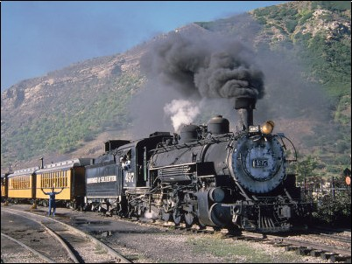
Not quite ...
Still in the Steam Age ...

Slide 40
Limitations, Issues
Requires an XML Schema
Starting with JSON is more difficult then XML
Recursive Structures not handled well
No way to target different rules for different levels
Namespaces
Limited support for managing namespaces
Lossy vs. Lossless vs. Bidirectional
Tools do not tell you what the result will be
Efficiency
can produce huge XSLT files
Mixed Content
Works but not elegantly handled
Schema Aware XSLT

Slide 41
An experiment ...
Schema information can be valuable in guiding transformations
Annotations are a workable notation
JSON/XML transformation is hard !
Nothing will make everyone happy or solve every use case
A mixture of languages can work well
Java +
XQuery +
XSLT +
Scripting
Software is still fun !

Slide 42
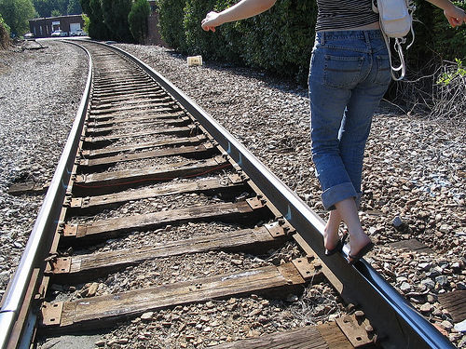
A long track ahead ...
Thank you !
David A. Lee
dlee@epocrates.com
For download visit: http://www.xmlsh.org
Open Source. BSD License.

